Slide 1

Цифровая и микроконтроллерная техника
Vlasov Sergey
smvlasov@itmo.ru

Slide 2
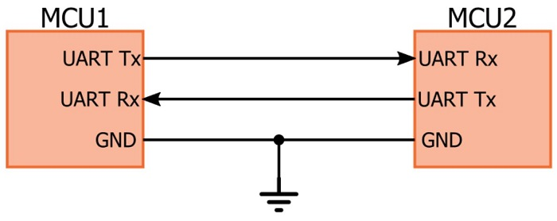
Universal asynchronous receiver-transmitter

Slide 3
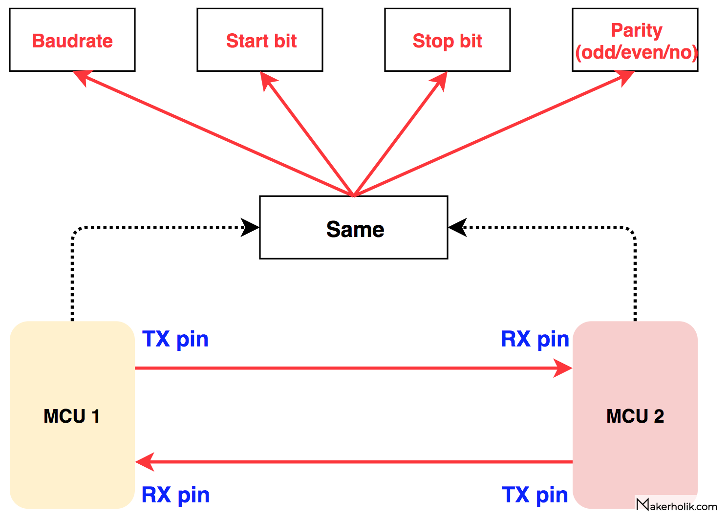
Protocol

Slide 4
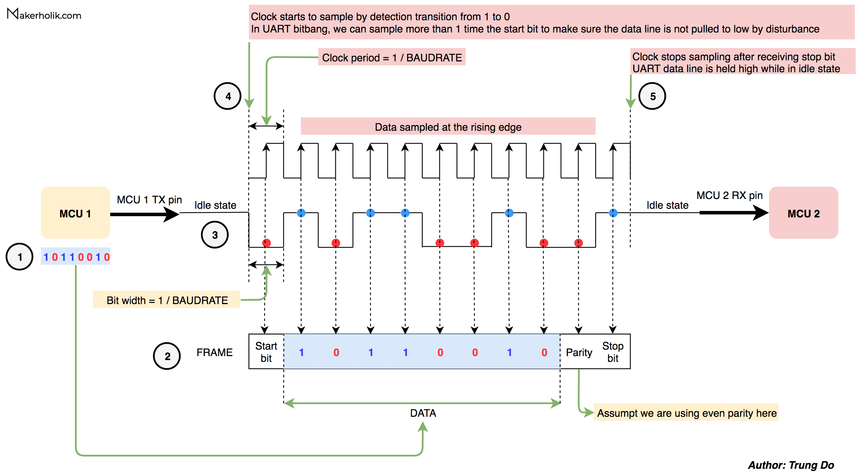
Operation

Slide 5
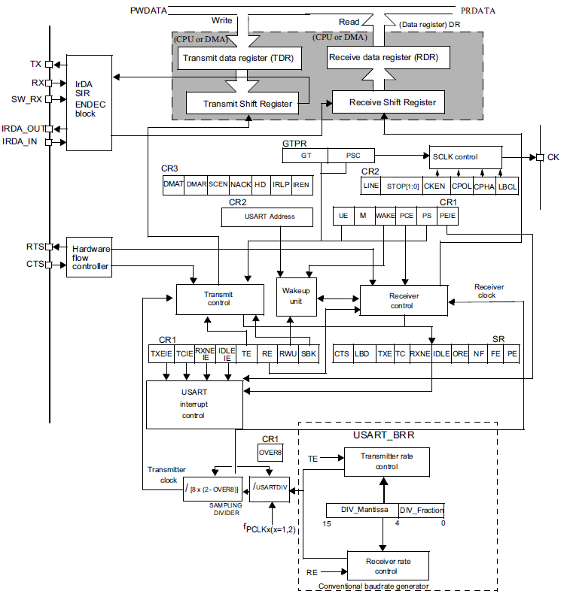
STM32F4xx USART

Slide 6
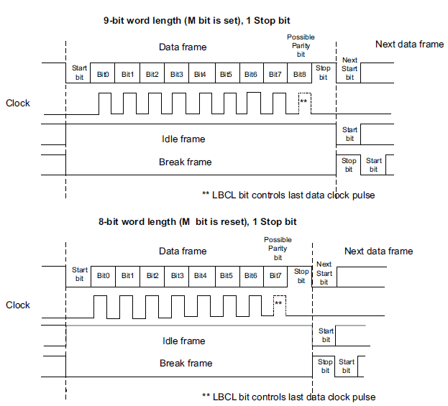
USART character description

Slide 7
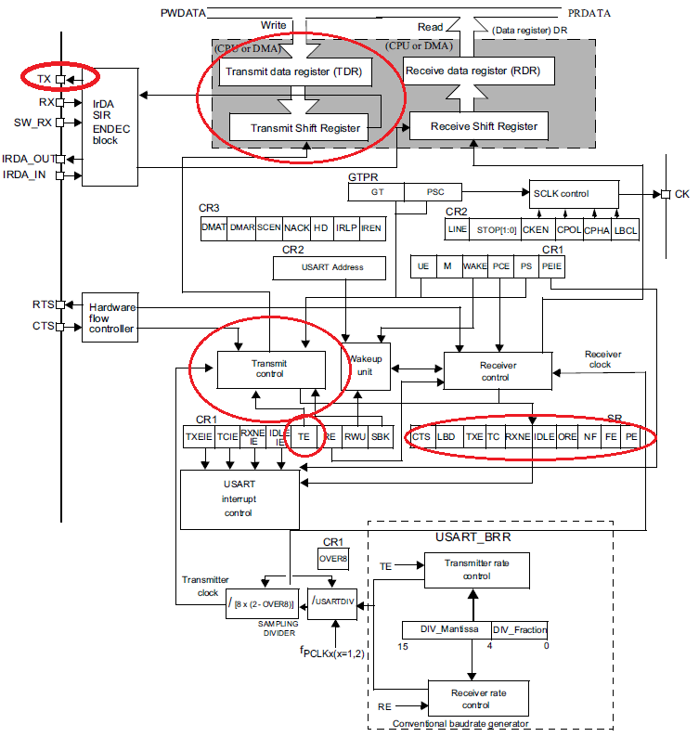
Transmitter

Slide 8
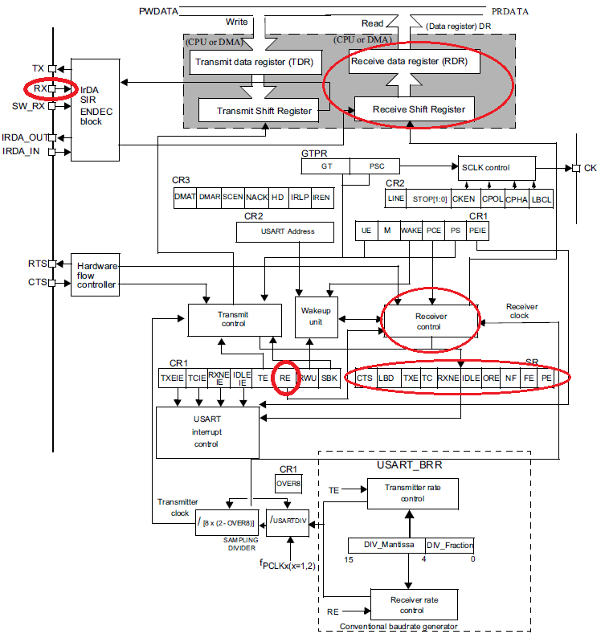
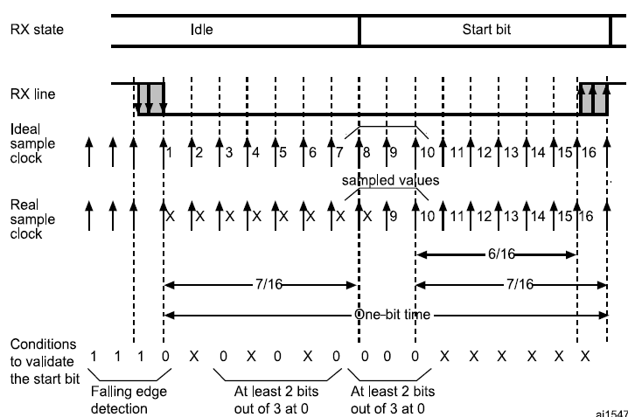
Receiver

Slide 9
USART Registers
USART Status register (USART_SR)
USART Data register (USART_DR)
USART Baud rate register (USART_BRR)
USART Control register 1 (USART_CR1)
USART Control register 2 (USART_CR2)
USART Control register 3 (USART_CR3)
USART Guard time and prescaler register (USART_GTPR)

Slide 10
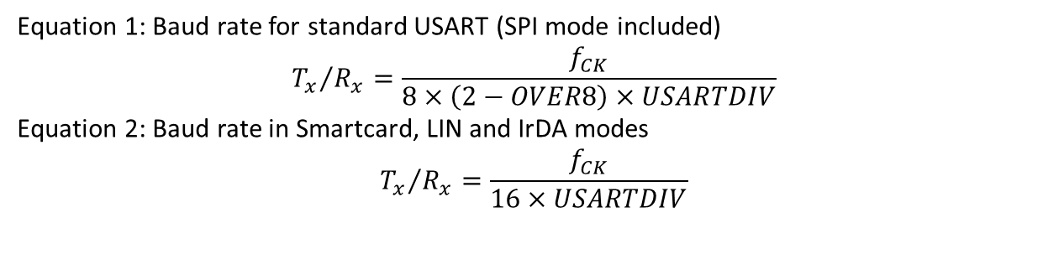

USART Registers
USART Baud rate register (USART_BRR)
Address offset: 0x08
Equation 1: Baud rate for standard USART (SPI mode included)
$${T_{x}}/{R_{x}}=\frac{f_{CK}}{8×\left(2−OVER8\right)×USARTDIV}$$
Equation 2: Baud rate in Smartcard, LIN and IrDA modes
$${T_{x}}/{R_{x}}=\frac{f_{CK}}{16×USARTDIV}$$
Example:
BAUDRATE = 19200
APBx_FREQ = 42000000
//define APBx frequency
#define APBx_FREQ 42000000
//define UART Baudrate
#define BAUDRATE 19200
//In main function set UART baudrate
USARTx->BRR = APBx_FREQ/BAUDRATE

Slide 11
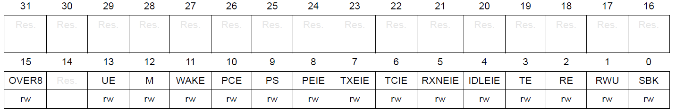
USART Registers
USART Control register 1 (USART_CR1)
Address offset: 0x0C
UE/TE/RE
0: USART/Transmitter/Receiver OFF
1: USART/Transmitter/Receiver ON
Enable interrupts
0: RXNEIE/TXEIE disable
1: RXNEIE/TXEIE enable

Slide 12
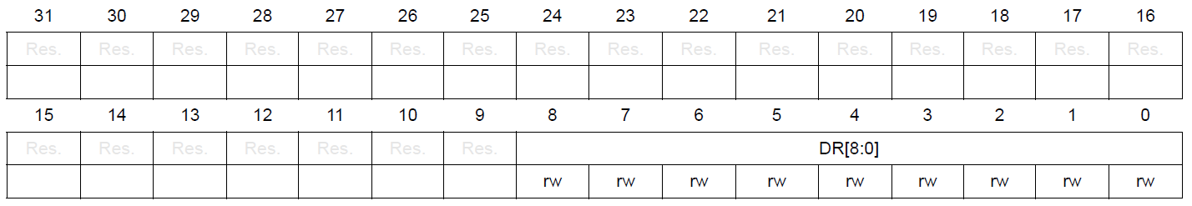
USART Registers
USART Data register (USART_DR)
Address offset: 0x04

Slide 13
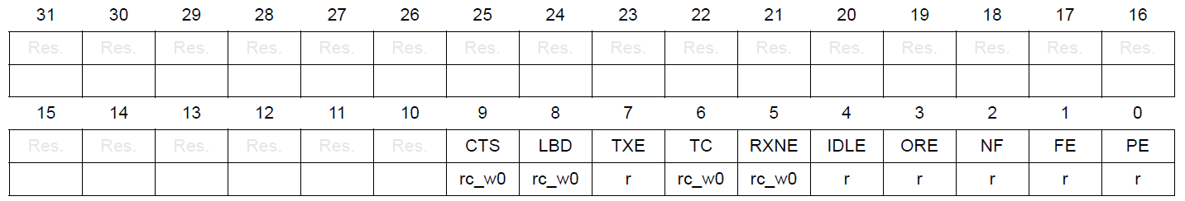
USART Registers
USART Status register (USART_SR)
Address offset: 0x00
PE: Parity error
FE: Framing error
NF: Noise detected flag
ORE: Overrun error
IDLE: IDLE line detected
RXNE: Read data register not empty
TC: Transmission complete
TXE: Transmit data register empty
LBD: LIN break detection flag
CTS: CTS flag

Slide 14
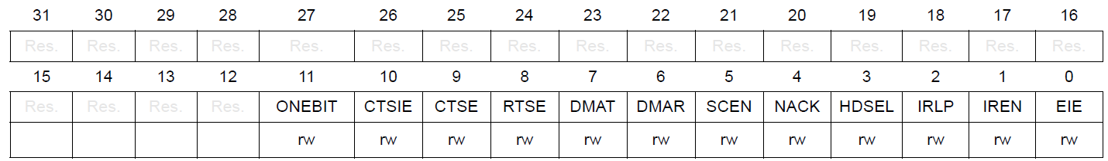
USART Registers
USART Control register 3 (USART_CR3)
Address offset: 0x14
DMA
0: DMA Transmitter/Receiver OFF
1: DMA Transmitter/Receiver ON

Slide 15
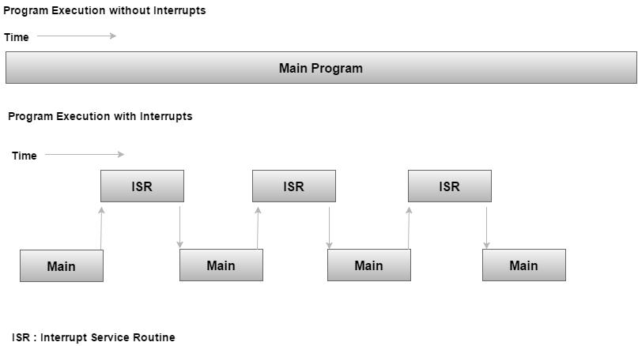
Interrupt

Slide 16
Nested Vector Interrupt Controller

Slide 17
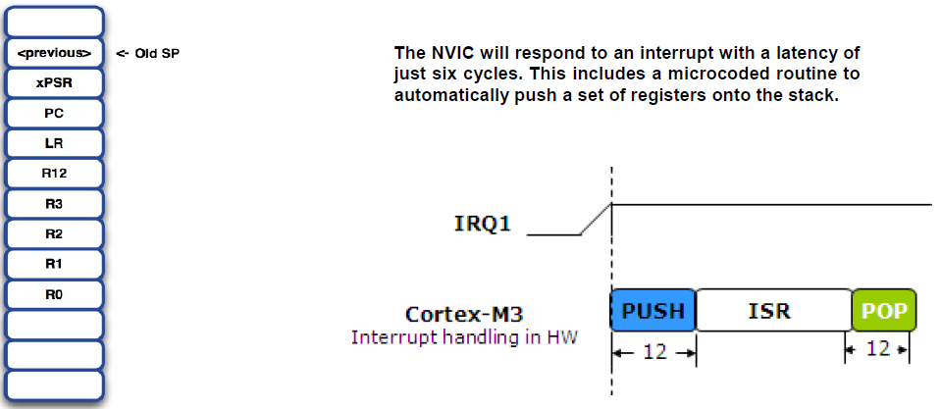
Nested Vector Interrupt Controller

Slide 18
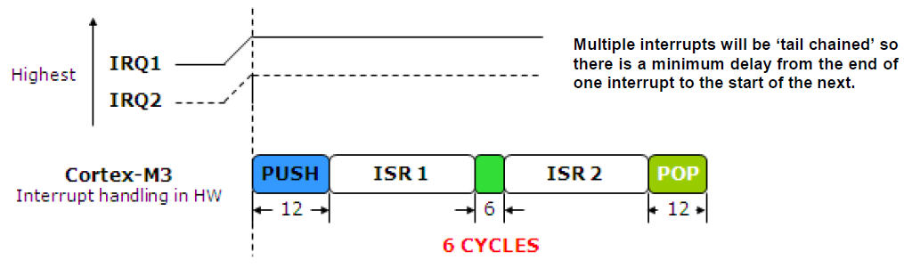
Nested Vector Interrupt Controller

Slide 19
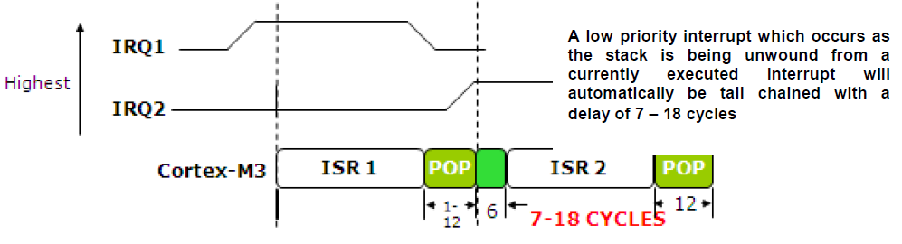
Nested Vector Interrupt Controller

Slide 20
Nested Vector Interrupt Controller

Slide 21
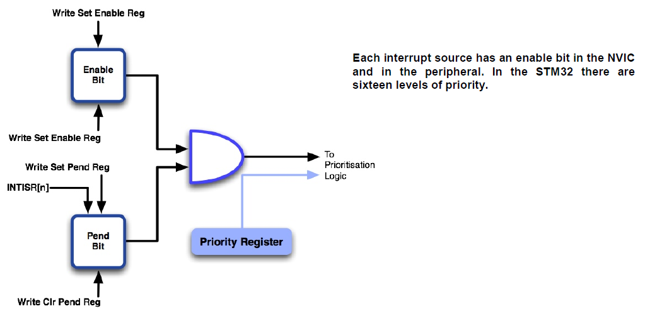
Nested Vector Interrupt Controller

Slide 22
Enabling Interrupt
//Create USART2 Interrupt Handler
void USART2_IRQHandler(void)
{
//Some actions
}
int main()
{ //Enable interrupt in peripheral
NVIC_EnableIRQ(USART2_IRQn); //Enable interrupt in NVIC
}

Slide 23

Thank you for attention
www.ifmo.ru

